Slide 1

Ho Chi Minh City University of Transport
Image Processing and Computer Vision
LOCAL OPERATORS & FOURIER TRANSFORM
Tran Le Anh
anhtl@ut.edu.vn
03-2025

Slide 2
Local Operators
Fourier Transform

Slide 3
Local Operators
Fourier Transform

Slide 4
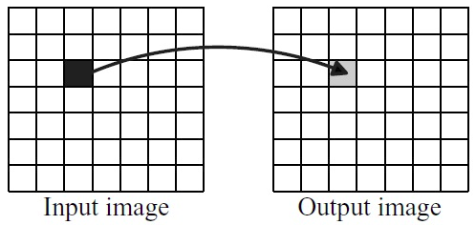
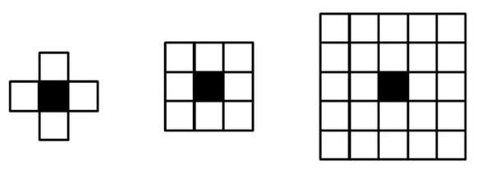
Local Operators
Definition
In computer vision, local operators, also called neighborhood operators, process images by considering a pixel's value relative to its surrounding pixels, unlike point operations which only consider a single pixel.

Slide 5
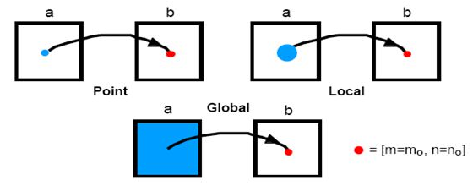
Local Operators
Local vs. Global Operators
- Local operators focus on a limited area (neighborhood) of pixels around a target pixel to determine the output value for that pixel.
- Global operators, on the other hand, consider the entire image when calculating the output pixel value.

Slide 6
Local Operators
Examples
- Convolution with Kernels: Sobel, Prewitt, Laplacian
- Smoothing Filters: Gaussian Blur, Mean Filter (Box Filter)
- Sharpening Filters: Unsharp Masking, High-Pass Filter
- Median Filter: Replaces each pixel with the median value of its neighborhood
- Morphological Operators: Dilation, Erosion

Slide 7
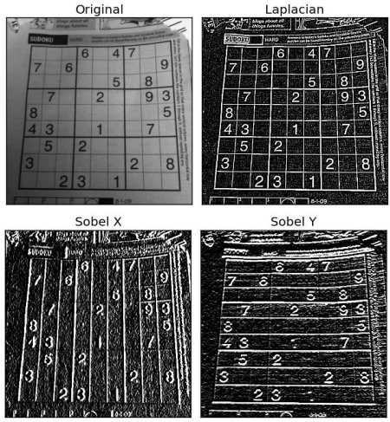
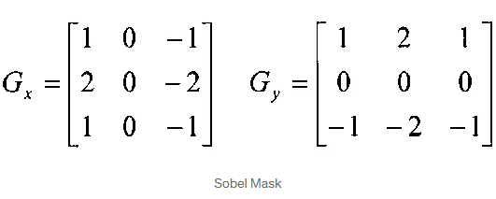
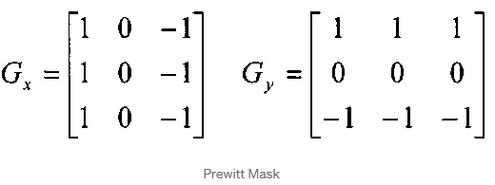
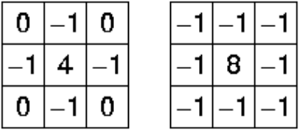
Local Operators
Convolution with Kernels
Laplacian

Slide 8
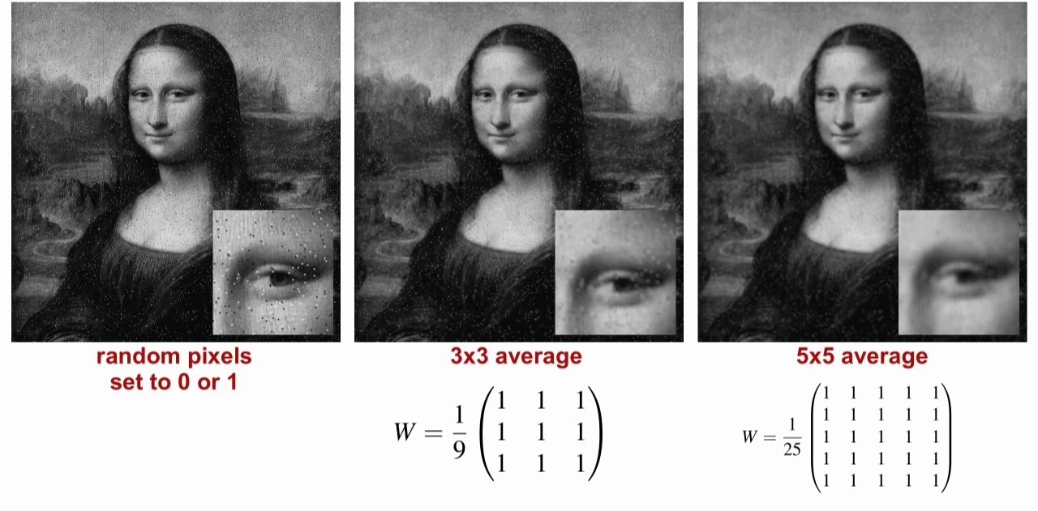
Local Operators
Smoothing Filters

Slide 9
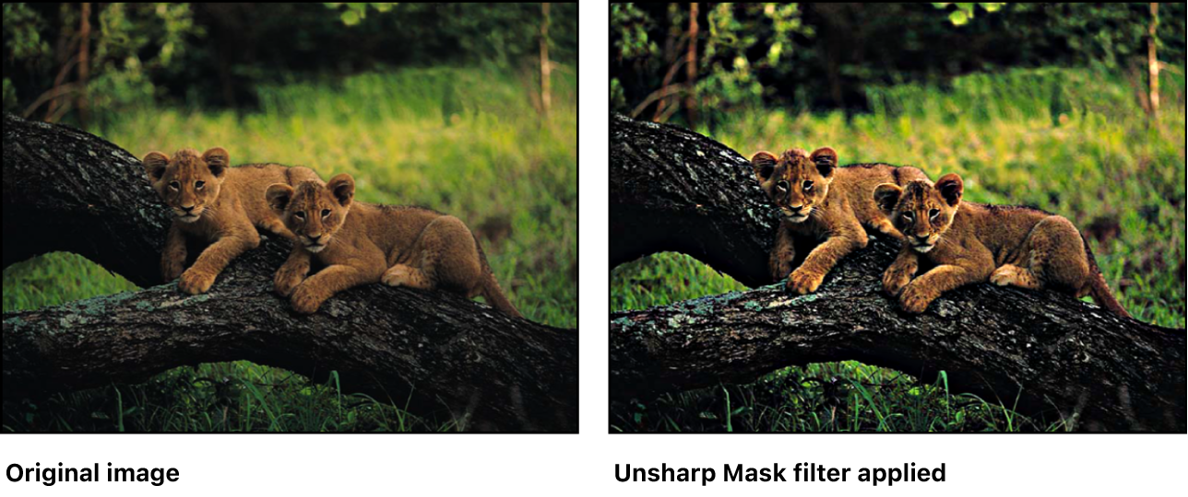
Local Operators
Sharpening Filter: Unsharp Masking
- S1_Blurring: A slightly blurred copy of the original image is created.
- S2_Subtraction: The blurred copy is subtracted from the original image.
- S3_Adding Back: The resulting difference (which highlights edges) is added back to the original image, creating a sharper appearance.
sharpened = original + (original − blurred) × amount

Slide 10
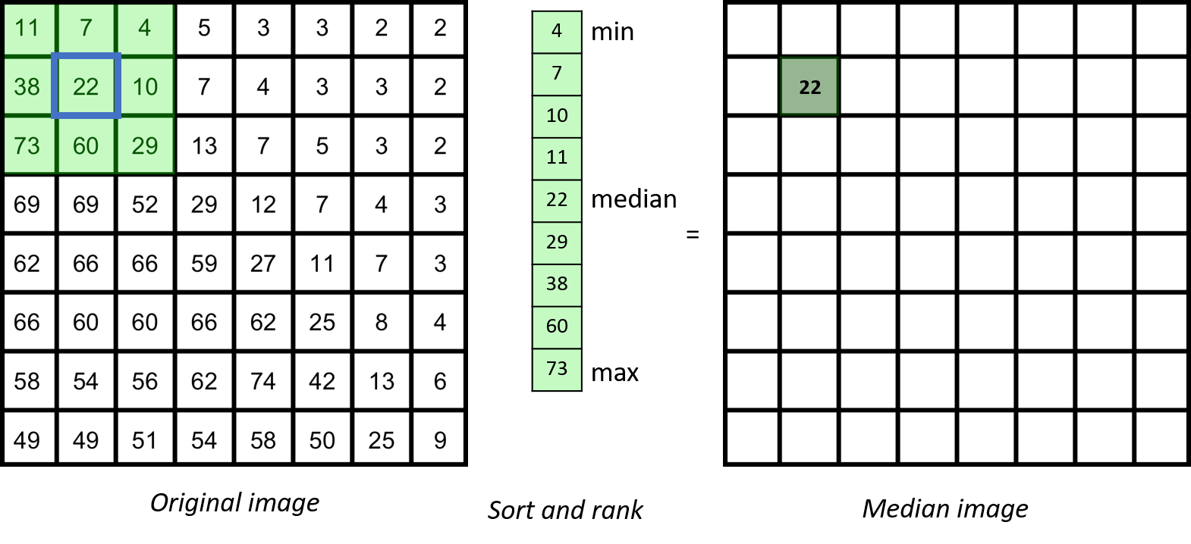
Local Operators
Median Filter
Effective for removing salt-and-pepper noise while preserving edges.
Ref: https://neubias.github.io/training-resources/median_filter/index.html

Slide 11
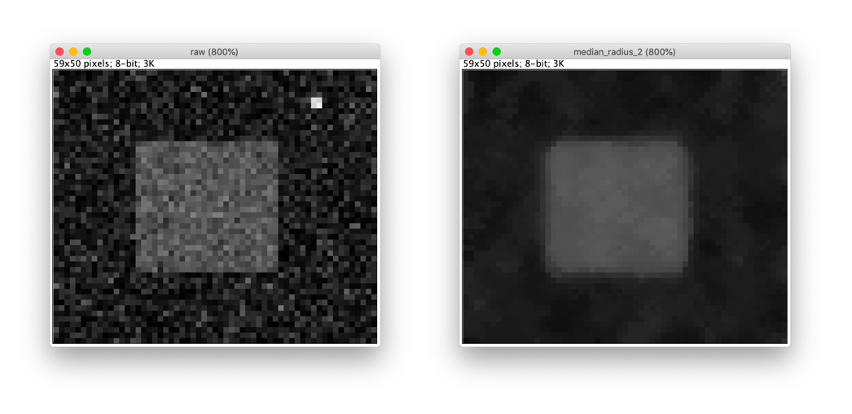
Local Operators
Median Filter
Median filter example: Left - Raw; Right - After a 5x5 median filter.
Ref: https://neubias.github.io/training-resources/median_filter/index.html

Slide 12
Local Operators
Morphological Operators
Dilation
- What it does: Expands or "grows" bright (foreground) regions in an image.
- How it works: For each pixel, the structuring element scans the image. If any pixel in the neighborhood matches the structuring element’s pattern, the central pixel is set to the maximum value (e.g., white in a binary image).
Erosion
- What it does: Shrinks or "erodes" bright (foreground) regions in an image.
- How it works: The structuring element scans the image, and the central pixel is set to the minimum value (e.g., black in a binary image) unless all pixels in the neighborhood match the structuring element’s pattern.

Slide 13
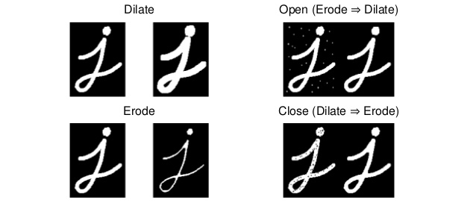
Local Operators
Morphological Operators

Slide 14
Local Operators
Fourier Transform

Slide 15
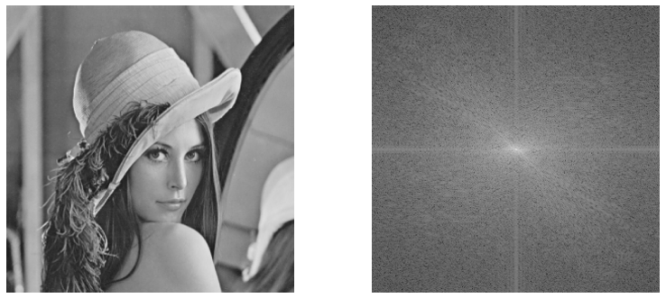
Fourier Transform
Concept
In image processing, the Fourier Transform decomposes an image into its frequency components, allowing for analysis and manipulation in the frequency domain, which is useful for tasks like filtering, noise reduction, and compression.
original
frequency distribution map

Slide 16

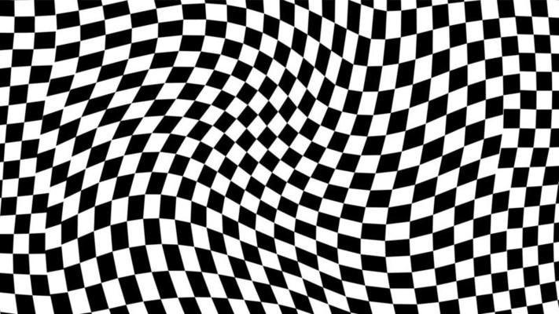
Fourier Transform
Why Frequency Domain?
In the frequency domain, the image is represented by its constituent frequencies, such as low frequencies (smooth areas) and high frequencies (edges and fine details).
- Low frequency: Refers to gradual changes in intensity over a large spatial region (e.g., smooth gradients, uniform areas). A smooth sky: Contains mostly low-frequency components because intensity changes gradually across the image.
- High frequency: Refers to rapid changes in intensity (e.g., edges, fine details, sharp transitions). A checkerboard pattern: Contains high-frequency components because intensity changes rapidly between black and white.

Slide 17
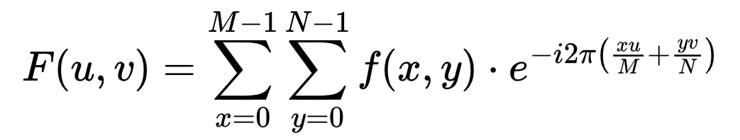
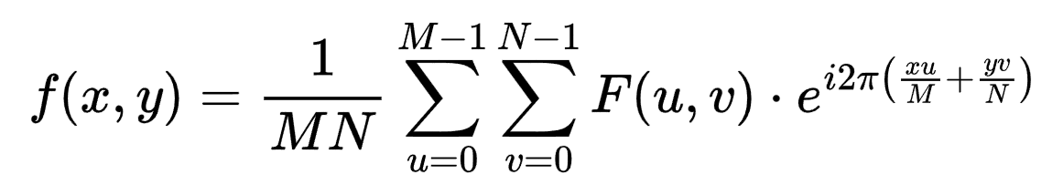
Fourier Transform
Discrete Fourier Transform (DFT)
DFT for 2D Image: Spatial Domain → Frequency Domain
Inverse DFT for 2D Image: Frequency Domain → Spatial Domain
f(x, y) is the pixel value at spatial coordinates (x, y)
F(u, v) is the Fourier transform value at frequency coordinates (u, v)
M and N are the image size

Slide 18
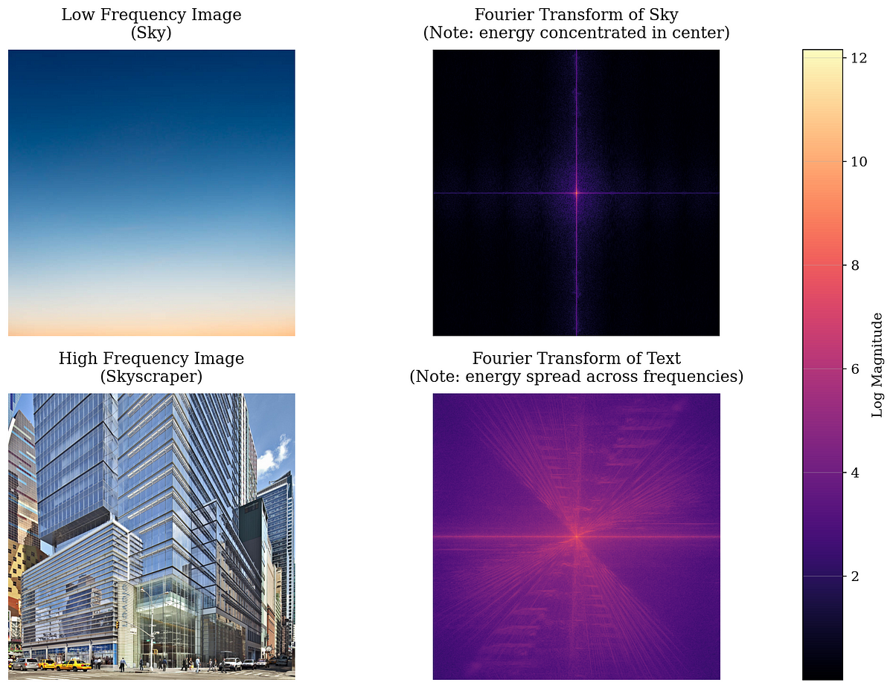
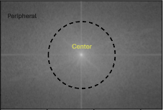
Fourier Transform
Frequency Image
- The center area corresponds to low frequencies (gradual changes like smooth gradients).
- The peripheral area corresponds to high frequencies (rapid changes like edges or fine details).

Slide 19
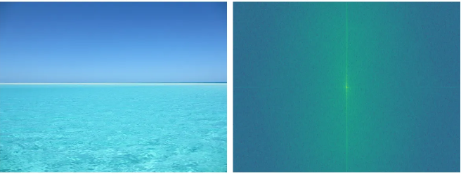
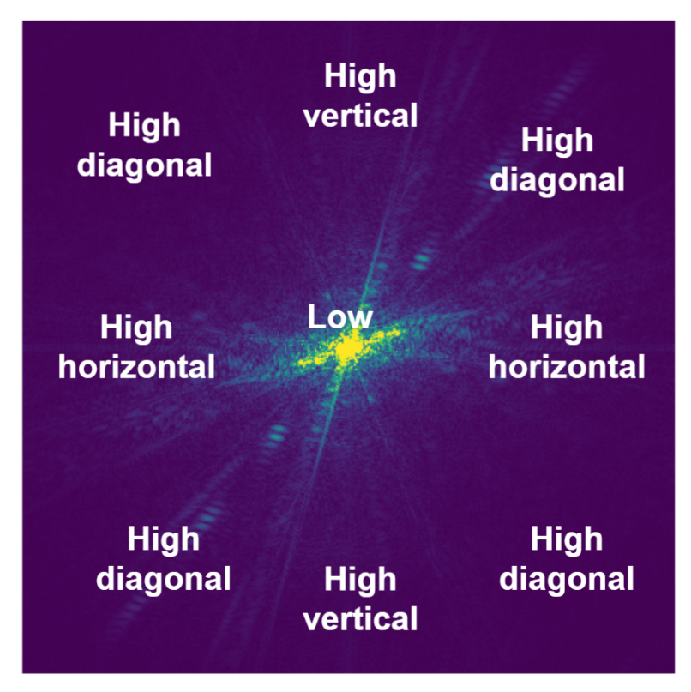
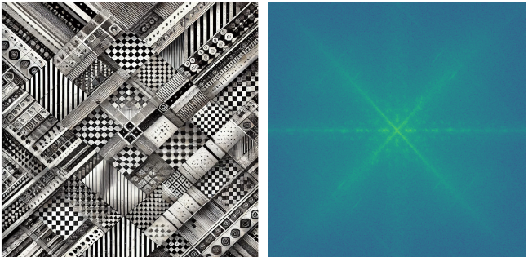
Fourier Transform
spatial domain
frequency domain
Frequency Image

Slide 20
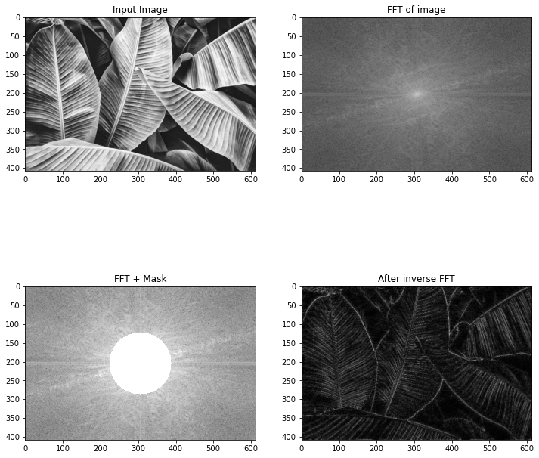
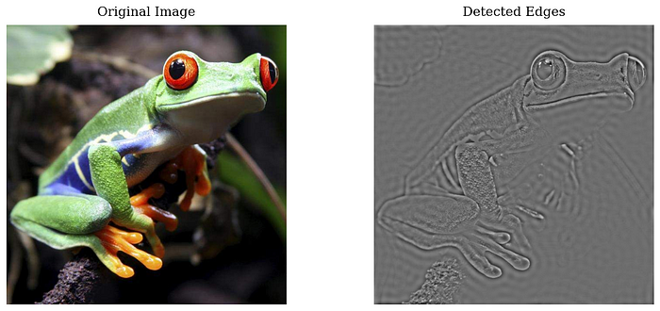
Fourier Transform
Applications
Edge Detection
- Transform an image using FT to frequency domain
- Leave only high frequencies to isolate the edge components
- Perform inverse FT to obtain the result

Slide 21
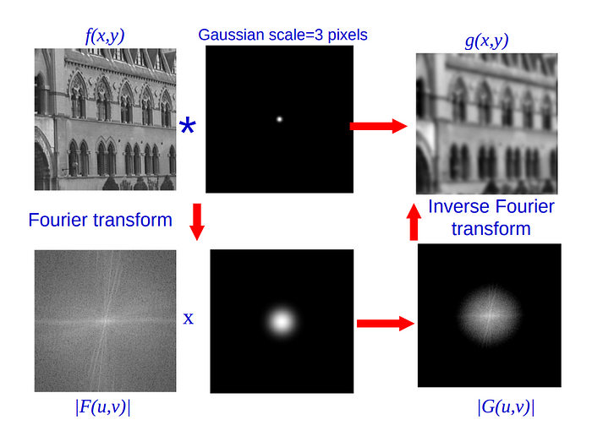
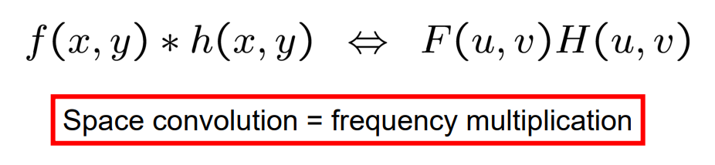
Fourier Transform
Applications
Image Smoothing
The Fourier transform of the convolution of two functions is the product of their individual Fourier transforms.
Ref: https://www.robots.ox.ac.uk/~az/lectures/ia/lect2.pdf

Slide 22
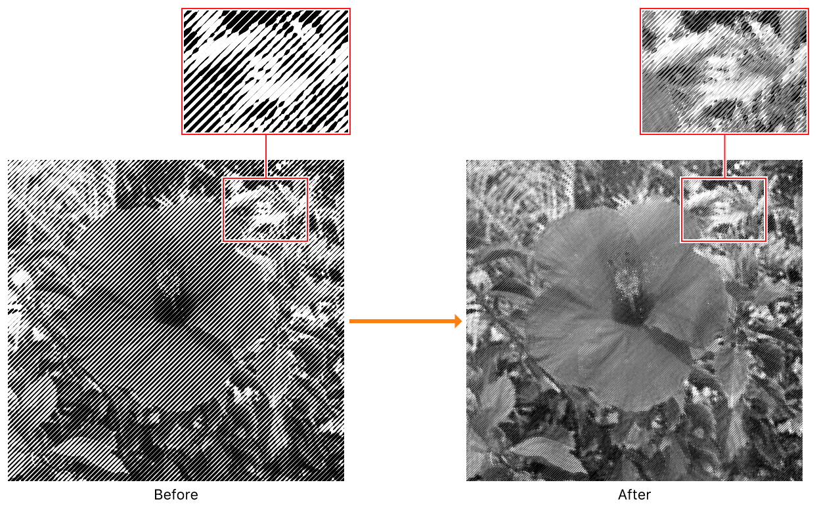
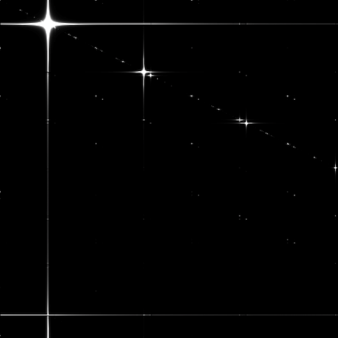
Fourier Transform
Applications
Halftone Descreening
The process of removing or reducing the visual artifacts (like dot patterns) caused by a halftone printing technique to create a smoother image.
Ref: https://developer.apple.com/documentation/accelerate/halftone-descreening-with-2d-fast-fourier-transform

Slide 23
Local Operators & Fourier Transform
Practice
- Local Operators
- Fourier Transform

Slide 24
Thank You
anhtl@ut.edu.vn

